Slide 1

Discovering a Global Data Model from Event Logs
Kim-Pascal Borchart
BPI @ HPI
Summer 2021

Slide 2
Agenda
Write your first topic here
Write your second topic here
Highlight your topics by using bold font (change manually)
Write your fourth topic here
If you need further details
Choose the second text layer

Slide 3
Baseline - Model Discovery on Single Event Log
Start
Attr_1
Bano, Dorina & Weske, Mathias. (2020). Discovering Data Models from Event Logs
Case | Activity | Time | Attr_1 | Attr_2 | Attr_3
1 | Start | 1 | True |  | hello
1 | Do | 2 |  | 9.001
2 | Start | 3 | False |  | hi
2 | Do | 4 |  | 8.999
1 | Finish | 4 | False |  | bye
2 | Finish | 5 | True |  | see you
3 | Start | 6 | False |  | howdy!
Do
Attr_2
Finish
Attr_3
1
Attr_1 Attr_3
2
Attr_2

Slide 4
Problem Definition
Multiple event logs => One data model
Case | Activity | Time | Attr_1 | Attr_2 | Attr_3
1 | Start | 1 | True |  | hello
1 | Do | 2 |  | 9.001
2 | Start | 3 | False |  | hi
2 | Do | 4 |  | 8.999
1 | Finish | 4 | False |  | bye
2 | Finish | 5 | True |  | see you
3 | Start | 6 | False
1
Attr_1 Attr_3
?
2
Attr_2
Case | Activity | Time | Attr_1 | Attr_2 | Attr_3
1 | Start | 1 | True |  | hello
1 | Do | 2 |  | 9.001
2 | Start | 3 | False |  | hi
2 | Do | 4 |  | 8.999
1 | Finish | 4 | False |  | bye
2 | Finish | 5 | True |  | see you
3 | Start | 6 | False
N
Attr_n-2 Attr_n-1 Attr_n

Slide 5
Approach – „Naive“
1
Attr_1 Attr_3
Case | Activity | Time | Attr_1 | Attr_2 | Attr_3
1 | Start | 1 | True |  | hello
1 | Do | 2 |  | 9.001
2 | Start | 3 | False |  | hi
2 | Do | 4 |  | 8.999
1 | Finish | 4 | False |  | bye
2 | Finish | 5 | True |  | see you
3 | Start | 6 | False
1
Attr_1 Attr_3
Start
Attr_1
2
Attr_2
Do
Attr_2
2
Attr_2
Finish
Attr_3
N
Attr_n-2 Attr_n-1 Attr_n
N-1
Attr_n-2 Attr_n-1 Attr_n
Case | Activity | Time | Attr_1 | Attr_2 | Attr_3
1 | Start | 1 | True |  | hello
1 | Do | 2 |  | 9.001
2 | Start | 3 | False |  | hi
2 | Do | 4 |  | 8.999
1 | Finish | 4 | False |  | bye
2 | Finish | 5 | True |  | see you
3 | Start | 6 | False
N
Attr_n-2 Attr_n-1 Attr_n
Start
Attr_1
Do
Attr_2
N
Attr_n-2 Attr_n-1 Attr_n
Finish
Attr_3

Slide 6
Approach – „Naive“ v2
Case | Activity | Time | Attr_1 | Attr_2 | Attr_3
1 | Start | 1 | True |  | hello
1 | Do | 2 |  | 9.001
2 | Start | 3 | False |  | hi
2 | Do | 4 |  | 8.999
1 | Finish | 4 | False |  | bye
2 | Finish | 5 | True |  | see you
3 | Start | 6 | False
Case | Activity | Time | Attr_1 | Attr_2 | Attr_3
1 | Start | 1 | True |  | hello
1 | Do | 2 |  | 9.001
2 | Start | 3 | False |  | hi
2 | Do | 4 |  | 8.999
1 | Finish | 4 | False |  | bye
2 | Finish | 5 | True |  | see you
3 | Start | 6 | False
1
Attr_1 Attr_3
Start
Attr_1
2
Attr_2
 |  |  | Case | Activity | Time | Attr_1 | Attr_2 | Attr_3
 |  |  | 1 | Start | 1 | True |  | hello
 |  |  | 1 | Do | 2 |  | 9.001
 |  |  | 2 | Start | 3 | False |  | hi
 |  |  | 2 | Do | 4 |  | 8.999
 |  |  | 1 | Finish | 4 | False |  | bye
 |  |  | 2 | Finish | 5 | True |  | see you
 |  |  | 3 | Start | 6 | False
Do
Attr_2
Case | Activity | Time | Attr_1 | Attr_2 | Attr_3
1 | Start | 1 | True |  | hello
1 | Do | 2 |  | 9.001
2 | Start | 3 | False |  | hi
2 | Do | 4 |  | 8.999
1 | Finish | 4 | False |  | bye
2 | Finish | 5 | True |  | see you
3 | Start | 6 | False
Finish
Attr_3
N
Attr_n-2 Attr_n-1 Attr_n

Slide 7
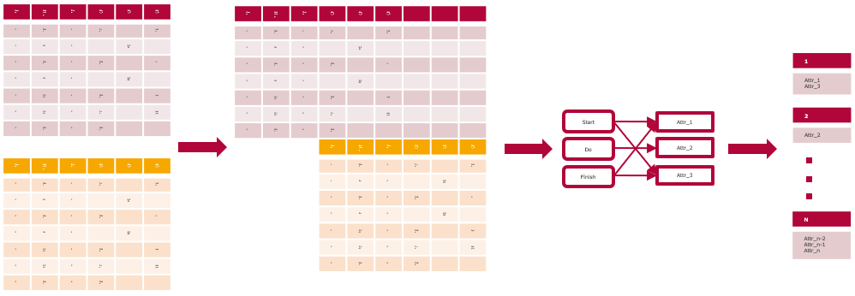
Approach – „Naive“

Slide 8
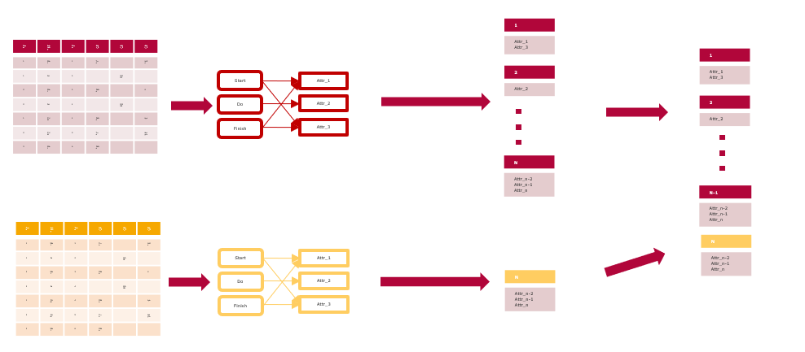
Approach – „Naive“ v2

Slide 9
A2A Diagrams - Example
Att1
A
Att2
B
Att3
C
Att4

Slide 10
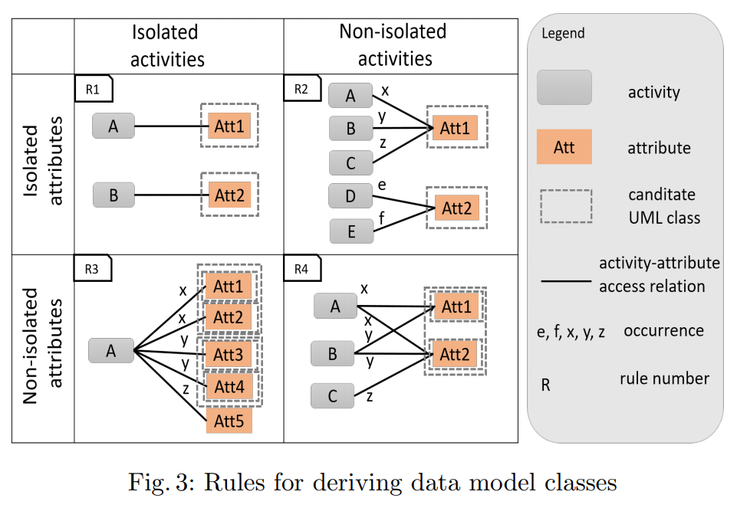
A2A Diagrams

Slide 11
A2A Diagrams - Example
Att1
A
Att2
B
Att3
C
Att4

Slide 12
A2A Diagrams - Example
Att1
A
Att2
B
Att3
Attr4

Slide 13
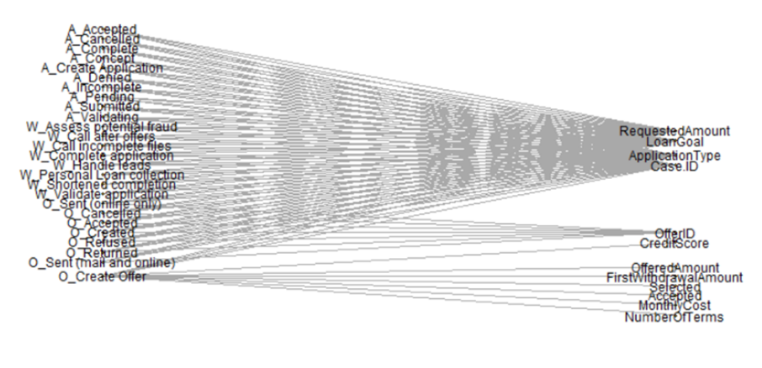
A2A Diagrams – Real World Example
A2A diagram for one BPI challenge 2017 event log

Slide 14
A2A Diagrams – Data Structure
A
x
Att1
x
y
Att2
B
x
y
Att3
C
x
Att4
 | Att1 | Att2 | Att3 | Att4
A | x | x | 0 | 0
B | y | x | y | 0
C | 0 | 0 | 0 | x

Slide 15
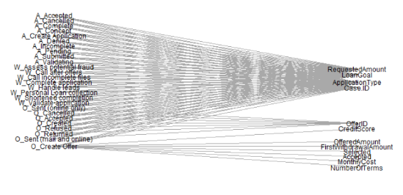
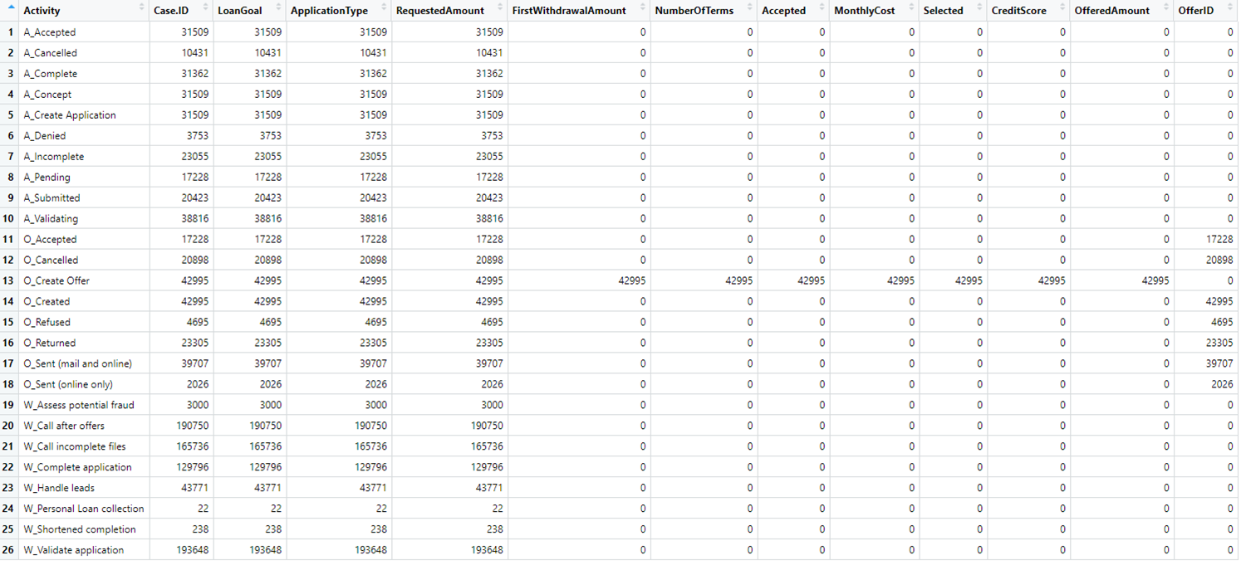
A2A Diagrams – Data Structure

Slide 16
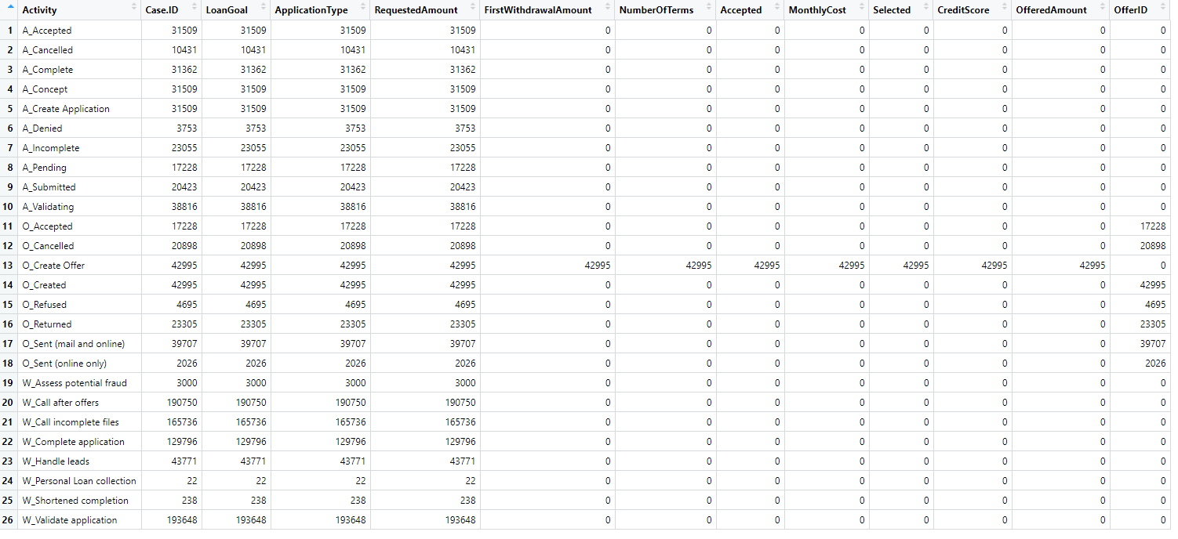
Underlying Schema – Which Attributes Belong Together?

Slide 17
Underlying Schema – Which Attributes Belong Together?
Activity | Att1 | Att2 | Att3 | Att4 | Att5 | Att6 | Att7
A |  |  |  |  | 0
B | 0 | 0 | 0 | 0 | x | 0 | 0
C |  |  |  |  | 0
D |  |  |  |  | 0
E |  |  |  |  | 0
Rule 1

Slide 18
Underlying Schema – Which Attributes Belong Together?
Activity | Att1 | Att2 | Att3 | Att4 | Att5 | Att6 | Att7
A |  |  |  |  | 0
B | 0 | 0 | 0 | 0 | x | 0 | 0
C |  |  |  |  | 0
D |  |  |  |  | 0
E |  |  |  |  | 0
Activity | Att1 | Att2 | Att3 | Att4 | Att5 | Att6 | Att7
A |  |  |  |  | 0
B | 0 | 0 | 0 | 0 | x | 0 | 0
C | 0 | 0 | 0 | 0 | x | 0 | 0
D | 0 | 0 | 0 | 0 | x | 0 | 0
E |  |  |  |  | 0
Rule 2

Slide 19
Underlying Schema – Which Attributes Belong Together?
Activity | Att1 | Att2 | Att3 | Att4 | Att5 | Att6 | Att7
A |  |  |  |  | 0
B | 0 | 0 | 0 | 0 | x | 0 | 0
C |  |  |  |  | 0
D |  |  |  |  | 0
E |  |  |  |  | 0
Activity | Att1 | Att2 | Att3 | Att4 | Att5 | Att6 | Att7
A |  |  | 0 | 0 | 0
B | 0 | 0 | x | x | x | 0 | 0
C |  |  | 0 | 0 | 0
D |  |  | 0 | 0 | 0
E |  |  | 0 | 0 | 0
Rule 3

Slide 20
Underlying Schema – Which Attributes Belong Together?
Activity | Att1 | Att2 | Att3 | Att4 | Att5 | Att6 | Att7
A |  |  |  |  | 0
B | 0 | 0 | 0 | 0 | x | 0 | 0
C |  |  |  |  | 0
D |  |  |  |  | 0
E |  |  |  |  | 0
Activity | Att1 | Att2 | Att3 | Att4 | Att5 | Att6 | Att7
A | z | 0 | 0 | m | n | z | 0
B | y | y | x | x | x | 0 | z
C | 0 | x | 0 | z | 0 | y | x
D | x | 0 | 0 | 0 | y | z | 0
E | 0 | y | 0 | x | 0 | 0 | x
Rule 4

Slide 21
Underlying Schema – Which Attributes Belong Together?
Activity | Att1 | Att2 | Att3 | Att4 | Att5 | Att6 | Att7
A |  |  |  |  | 0
B | 0 | 0 | 0 | 0 | x | 0 | 0
C |  |  |  |  | 0
D |  |  |  |  | 0
E |  |  |  |  | 0
Activity | Att1 | Att2 | Att3 | Att4 | Att5 | Att6 | Att7
A | z | 0 | 0 | m | n | z | 0
B | y | y | x | x | x | 0 | z
C | 0 | x | 0 | z | 0 | y | x
D | x | 0 | 0 | 0 | y | z | 0
E | 0 | y | 0 | x | 0 | 0 | x
Activity | Att1 | Att2 | Att3 | Att4 | Att5 | Att6 | Att7
A | z | 0 | 0 | m | n | z | 0
B | y | y | x | x | x | 0 | z
C | 0 | x | 0 | z | 0 | y | x
D | x | 0 | 0 | 0 | y | z | 0
E | 0 | y | 0 | x | 0 | 0
Rule 4

Slide 22
Underlying Schema – Which Attributes Belong Together?
Activity | Att1 | Att2 | Att3 | Att4 | Att5 | Att6 | Att7
A |  |  |  |  | 0
B | 0 | 0 | 0 | 0 | x | 0 | 0
C |  |  |  |  | 0
D |  |  |  |  | 0
E |  |  |  |  | 0
Activity | Att1 | Att2 | Att3 | Att4 | Att5 | Att6 | Att7
A | z | 0 | 0 | m | n | z | 0
B | y | y | x | x | x | 0 | z
C | 0 | x | 0 | z | 0 | y | x
D | x | 0 | 0 | 0 | y | z | 0
E | 0 | y | 0 | x | 0 | 0 | x
Activity | Att1 | Att2 | Att3 | Att4 | Att5 | Att6 | Att7
A | z | 0 | 0 | m | n | z | 0
B | y | y | x | x | x | 0 | z
C | 0 | x | 0 | z | 0 | y | x
D | x | 0 | 0 | 0 | y | z | 0
E | 0 | y | 0 | x | 0 | 0 | x
Rule 4

Slide 24
Rules in Data - Rule 1
Activity | Att1 | Att2 | Att3 | Att4 | Att5 | Att6 | Att7
A |  |  |  |  | 0
B | 0 | 0 | 0 | 0 | x | 0 | 0
C |  |  |  |  | 0
D |  |  |  |  | 0
E |  |  |  |  | 0

Slide 25
Rules in Data - Rule 2
Activity | Att1 | Att2 | Att3 | Att4 | Att5 | Att6 | Att7
A |  |  |  |  | 0
B | 0 | 0 | 0 | 0 | x | 0 | 0
C | 0 | 0 | 0 | 0 | x | 0 | 0
D | 0 | 0 | 0 | 0 | x | 0 | 0
E |  |  |  |  | 0

Slide 26
Rules in Data - Rule 3
Activity | Att1 | Att2 | Att3 | Att4 | Att5 | Att6 | Att7
A |  |  | 0 | 0 | 0
B | 0 | 0 | x | x | x | 0 | 0
C |  |  | 0 | 0 | 0
D |  |  | 0 | 0 | 0
E |  |  | 0 | 0 | 0

Slide 27
Rules in Data - Rule 4
Activity | Att1 | Att2 | Att3 | Att4 | Att5 | Att6 | Att7
A | z | 0 | 0 | m | n | z | 0
B | y | y | x | x | x | 0 | z
C | 0 | x | 0 | z | 0 | y | x
D | x | 0 | 0 | 0 | y | z | 0
E | 0 | y | 0 | x | 0 | 0 | x

Slide 28
Rule 4
Activity | Att1 | Att2 | Att3 | Att4 | Att5 | Att6 | Att7
A | z | 0 | 0 | m | n | z | 0
B | y | y | x | x | x | 0 | z
C | 0 | x | 0 | z | 0 | y | x
D | x | 0 | 0 | 0 | y | z | 0
E | 0 | y | 0 | x | 0 | 0 | x

Slide 29
Rule 4
Activity | Att1 | Att2 | Att3 | Att4 | Att5 | Att6 | Att7
A | z | 0 | 0 | m | n | z | 0
B | y | y | x | x | x | 0 | z
C | 0 | x | 0 | z | 0 | y | x
D | x | 0 | 0 | 0 | y | z | 0
E | 0 | y | 0 | x | 0 | 0 | x

Slide 31
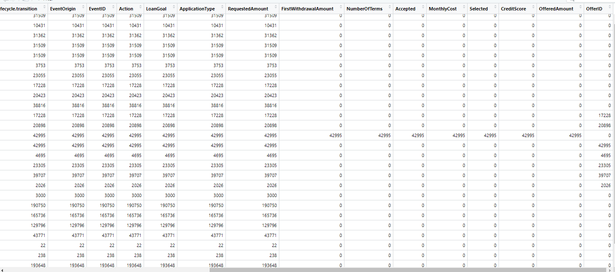

Slide 32
t1
FirstWithdrawalAmount
NumberOfTerms
Accepted
MonthlyCost
Selected
CreditScore
OfferedAmount

Slide 33
t1
FirstWithdrawalAmount
NumberOfTerms
Accepted
MonthlyCost
Selected
CreditScore
OfferedAmount

Slide 37
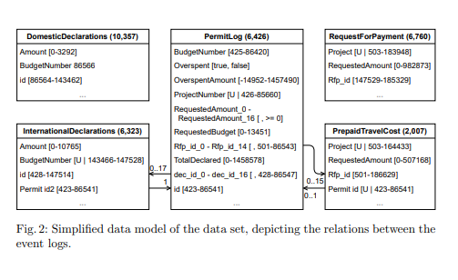
Key Matching

Slide 38
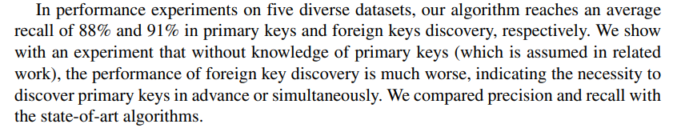
Key Matching
Jiang, L., Naumann, F. Holistic primary key and foreign key detection. J Intell Inf Syst 54, 439–461 (2020)

Slide 39
Definition: Fully connected event logs
Event logs in which all activities access all attributes
Att1
 | Att1 | Att2 | Att3
A | x | x | x
B | x | x | x
C | x | x | x
A
Att2
B
Att3
C
Att4

Slide 40
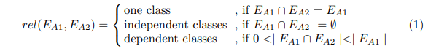

Slide 41
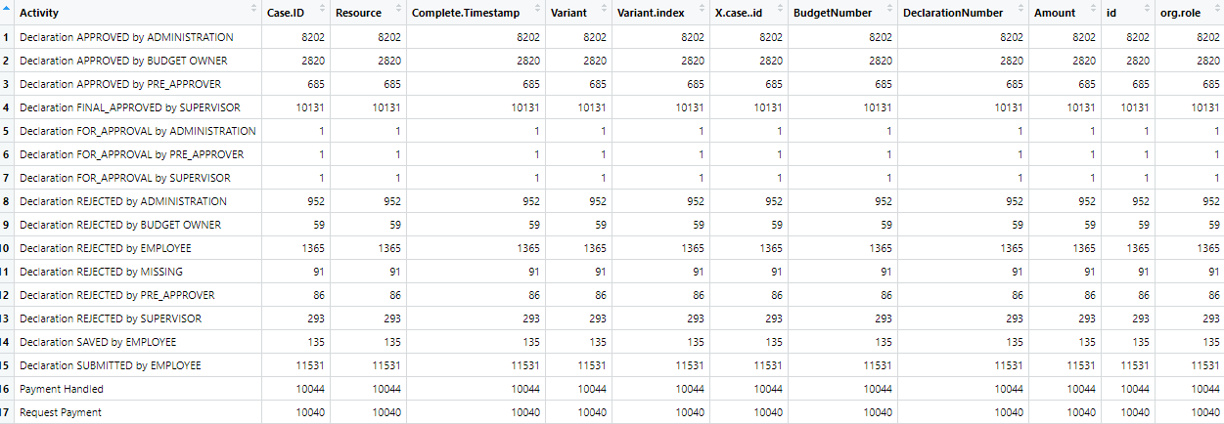
Definition: Fully connected event logs
Event logs in which all activities access all attributes
Att1
A
Att2
B
Att3
C
Att4
#accesses (absolute)

Slide 42
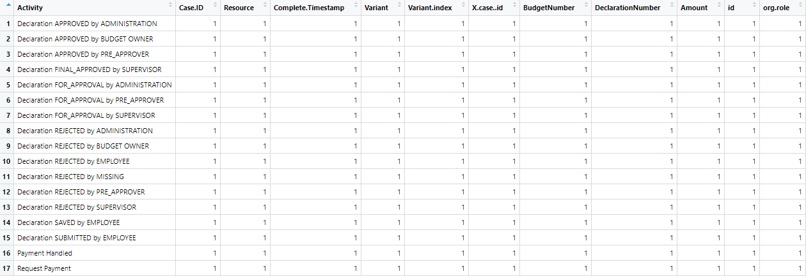
Definition: Fully connected event logs
Event logs in which all activities access all attributes
Att1
A
Att2
B
Att3
C
Att4
#accesses (relative to #activity)

Slide 43
Multiple Event Log Characteristics
One „Main“ Log
Secondary event logs often fully connected

Slide 45
Thank you for your attention!
Speaker
Job Description
Institute

Slide 46
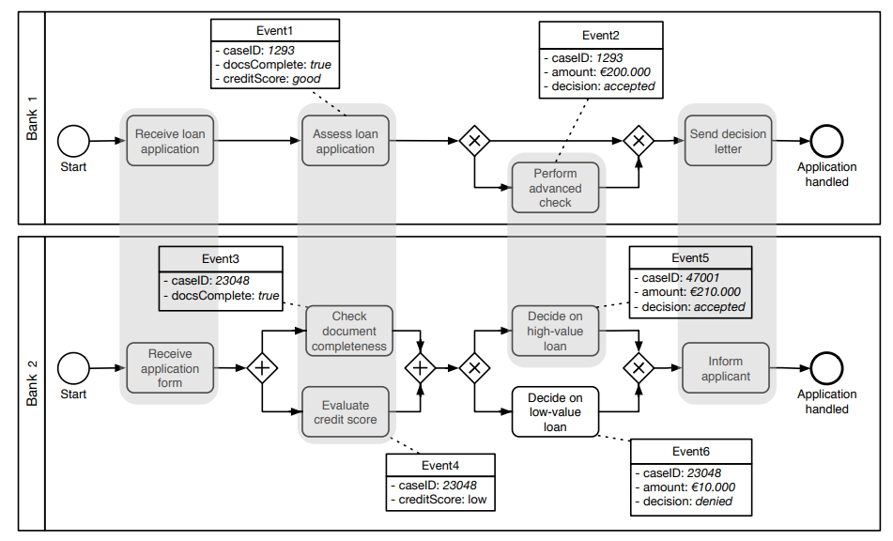
Related Work – Schema Matching on Event Logs
van der Aa, Han & Gal, Avigdor & Leopold, Henrik & Reijers, Hajo & Sagi, Tomer & Shraga, Roee. (2017). Instance-Based Process Matching Using Event-Log Information.
Instance-based approach
Attribute Name Similarity
Attribute Value Similarity
Occurrence Similarity (frequency)
Additional process-related metrics:
Positional Similarity
Duration Similarity
Prerequisites Similarity

Slide 47
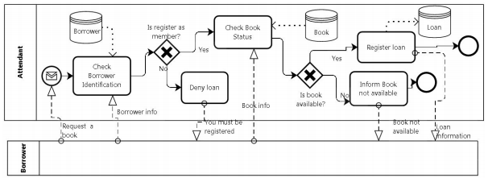
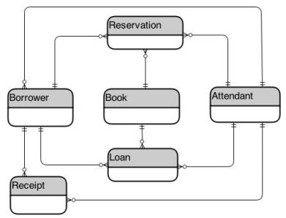
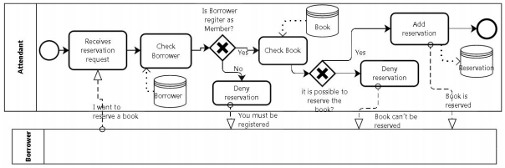
Related Work – Deriving Data Model from Related BPMs
Cruz, Estrela & Machado, Ricardo-J & Santos, Maribel. (2015). Deriving a Data Model from a Set of Interrelated Business Process Models.

Slide 48
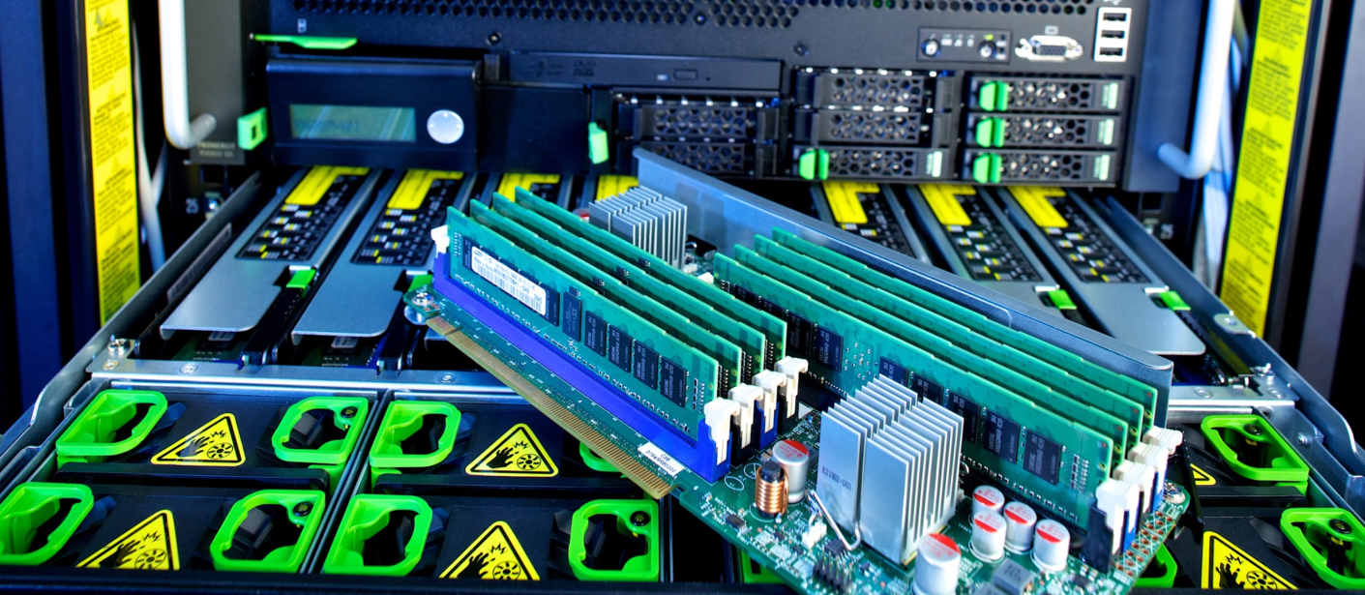

Slide 49
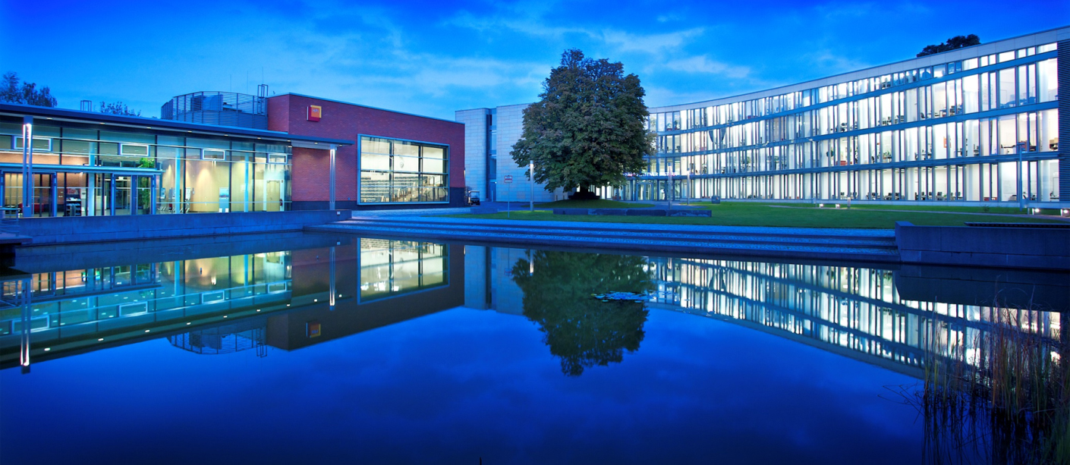

Slide 50
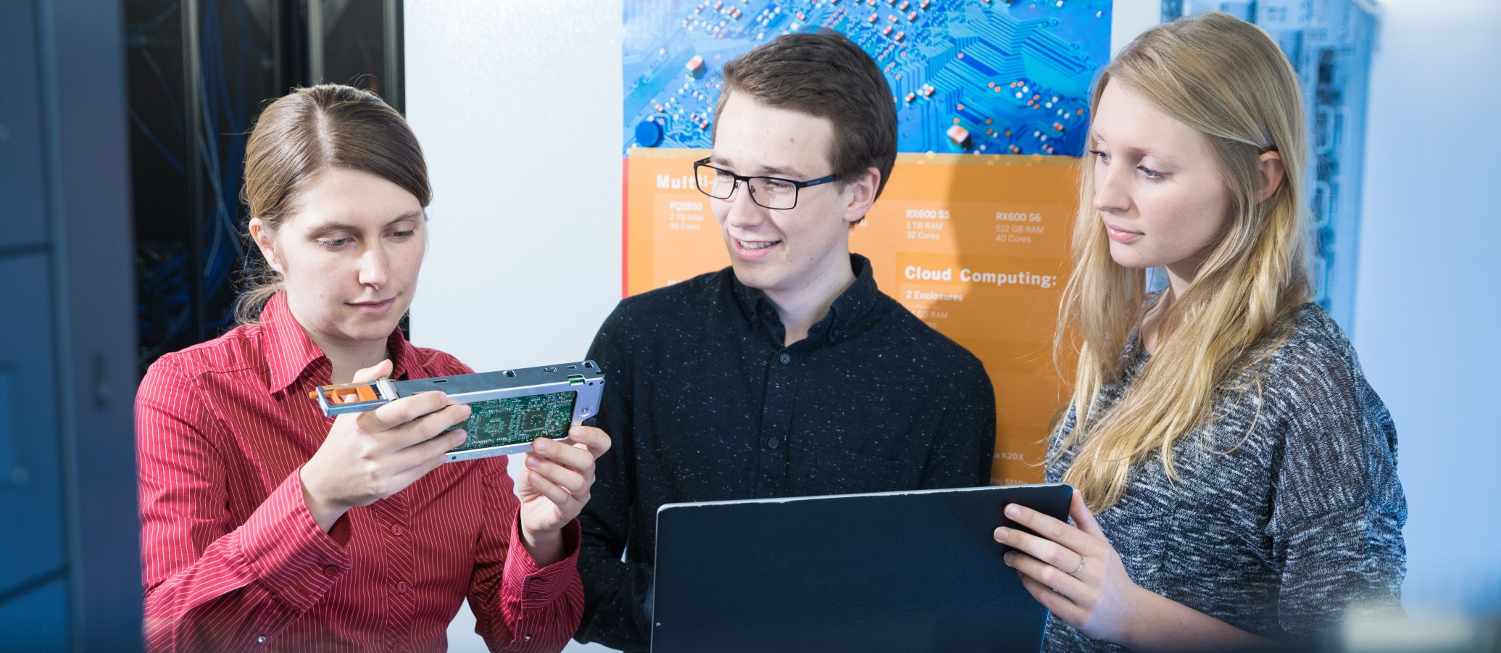

Slide 51
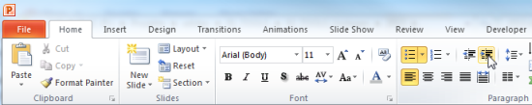
Explanations - Text layers
First text layer for running text.
Second level for bullet points
Third level for bullet points
Fourth level for bullet points
Fifth level for numberings
Sixth level for listings
Seventh text layer for Core Messages
In this template, we pre-formatted different text layers (as you can see on the right side). You don’t have to generate bullet points manually. By the way: Please avoid this!
To change from one text layer to the next, use the Increase / Decrease List Level buttons:

Slide 52
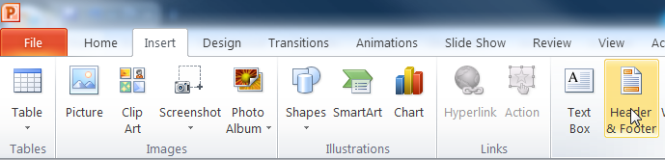
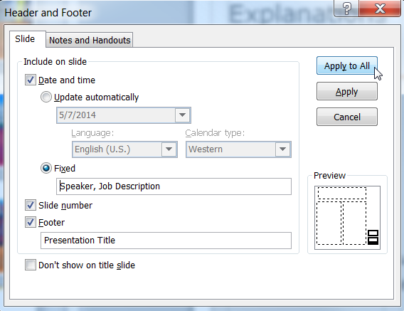
Explanations - Footer
You can insert or change your presentation‘s footer. Click on the Insert-tab | Header and Footer | After filling in your descriptions click on Apply to All.
Descriptions:
Activate date and time and write in:Speaker, Job Description
Activate the slide number.
Activate the footer and write in: Presentation Title
Don‘t use the template without the complete footer.

Slide 53
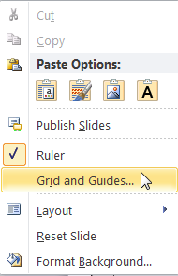
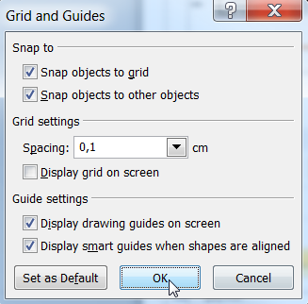
Explanations - Drawing guides
You can enable your guide-lines to align objects on the slide (View | Show | Select the option „Guides“)
Or hit the right mouse button outside the slide and go at „Grid and Guides…“

Slide 54
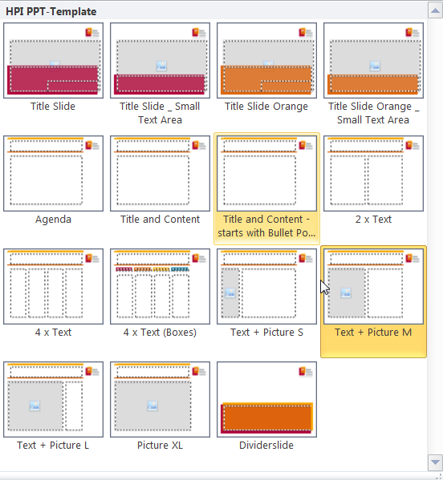
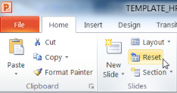
Explanations - Slide layouts
You can choose between different slide layouts. These pre-defined layouts gives you the oportunity to use text and visualisations just the right way.
To use these layouts:
Click on the Home-tab | New Slide or Layout | and choose one out of the layouts
Click „Reset“ to reset to the predefined slide layout.

